Slide 1
Artificial intelligence
PREPARED BY :RAYJADA VIDHIBA

Slide 2
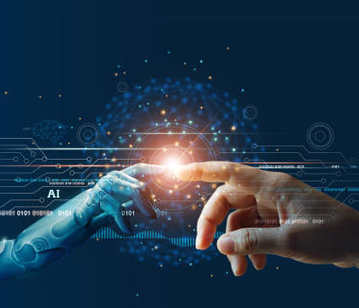
(AI)
FULL FORM-ARTIFICIAL INTELIGENCE

Slide 3
Introduction
AI is a one type of robot its work like human bieng. At its simplest form, artificial intelligence is a field, which combines computer science and robots datasets, to enable problem-solving. It also encompasses sub-fields of machine learning and deep learning, which are frequently mentioned in conjunction with artificial intelligence.

Slide 4
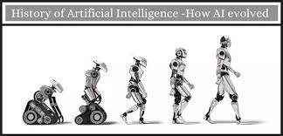
History of (AI)
Year 1943: The first work which is now recognized as AI was done by Warren McCulloch and Walter pits in 1943. They proposed a model of artificial neurons. Year 1949: Donald Hebb demonstrated an updating rule for modifying the connection strength between neurons..

Slide 5
How to work (AI)
If AI is a complex but necessary technology, how does it work? To put it simply, AI works by combining large data sets with intuitive processing algorithms. AI can manipulate these algorithms by learning behavior patterns within the data set. It's important to understand that AI is not just one algorithm.

Slide 6

Current status of (AI)
AI-enhanced technologies and solutions are now more widely available than before across industries, though they are not necessarily cheap to implement. Voice-based assistants are at the forefront of the AI adoption process in industries as diverse as IT, automotive, and retail.

Slide 7
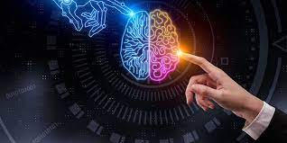
Future of(AI)
At all levels of education, AI will likely be transformative. Students will receive educational content and trainings tailored to their specific needs. AI will also determine optimal educational strategies based on students' individual learning styles. By 2028, the education system could be barely recognizable.

Slide 8
conclusion
AI leads to transformative applications within a series of industrial, intellectual, and social applications, far beyond those caused by previous industrial revolutions. Furthermore, AI has proven to be superior to human decision-making in certain areas.

Slide 9
(AI)
Advantage
Disadvantage
Reduction in Human Error.
Zero Risks. ...
24x7 Availability. ...
Digital Assistance. ...
New Inventions. ...
Unbiased Decisions. ...
Perform Repetitive Jobs. ...
Daily Applications.
A big disadvantage of AI is that it cannot learn to think outside the box. AI is capable of learning over time with pre-fed data and past experiences, but cannot be creative in its approach.

Slide 10


